Slide 1


Slide 2



Advanced MS Excel: Business Intelligence with Data Visualization
***2025 UPDATE***
Welcome to Orientation
Session

Slide 3

Agenda
Glance of Professional MS Excel
Why Learn MS Excel
Salient Features of MS Excel
Learning Outcomes
Program Outline by Sub Module
Recent Developments In Dashboard
Live Practical Exposure
Emerging Career paths
About YouExcel and Training Facilitator
Schedule and Fee with Special Offer

Slide 4
Glance of Professional MS Excel
Excel-based BI tools empower users to view their data in dashboards and reports
Pulling data from multiple sources in real-time
Share it with others

Slide 5
Why Learn MS Excel
Business Analysis: The #1 use for Microsoft Excel in the workplace is to do business analysis
People Management
Managing Operations
Performance Reporting
Office Administration
Strategic Analysis
Project Management
Managing Programmes

Slide 6
Salient Features of MS Excel
Spreadsheet Organization: Create, manage, and organize data in rows and columns efficiently.
Formulas and Functions: Use built-in formulas to automate data calculation for reporting
Data Analysis Tools: Sort, filter, and analyze data with tools like PivotTables

Slide 7
Salient Features of MS Excel
Data Visualization: Visualize data patterns and trends by creating various charts, graphs and Dashboards
Power Pivot: Excel's Power Pivot enables users to create data models, perform complex data analysis, and manage larger datasets more efficiently
Power Query: Easily discover, connect, and transform data from various sources for analysis and reporting
Difficulty Level: Intermediate to Advanced
Target Audience: Sales and Marketing Analysis, Business Analysts, Finance & Accounts, Data Analysts and Data Scientists, Project Managers, Operations and Logistics Manager, HR Professionals, IT Professionals

Slide 8
Learning Outcomes
Leverage tools and functions to format and prepare data in MS Excel
Integrate data from various sources by using Power Query in MS Excel
Represent data by highlighting trends using Pivot Tables
Apply Data Security features to protect and distribute MS Excel ﬁles
Design user-friendly automated Dashboards with interactive features, time-based analysis and customizable views
Leverage Copilot to generate automated insights, simplify complex data analysis, and create interactive visualizations

Slide 9
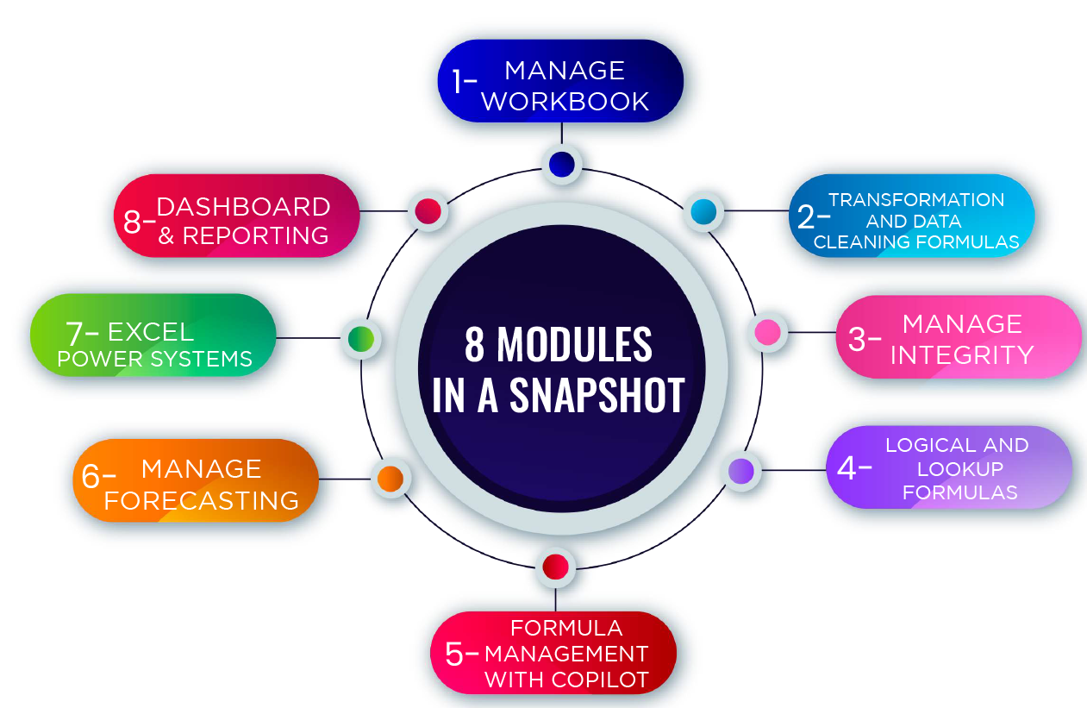
Program Outline in Snapshot

Slide 10
Program Outline by Sub-Modules
Module 1: Manage Workbook
Overview (Interface/Tools/Options)
Security (Editing/Restricted sharing/ Book-Sheet-Cell Protection)
Tips & Tricks (Short cut keys / Techniques)
Module 2: Format/Cleaning Data ***2025 UPDATE***
Cleaning Formulas (Text/Trim/IsText/Right/Left/Mid/Upper/Lower/Proper/Len/Clean/Find)
Wrap rows/Wrap columns/Group By/VStack/HStack/Filter Unique/Distinct/Sequence/Sort/Substitute
Subtotal/Aggregate
Flash Fill/Fill Series
Text to Column (Fixed/Delimited)
Remove Duplicate (By Conditional Formatting)
Tips & Tricks (Short Keys/ Techniques)

Slide 11
Program Outline by Sub-Modules
Module 3: Manage Integrity
Data Validation
Group/Ungroup Data
Conditional Formatting (Simple/Advance)
Data Consolidations
Filtering (Simple/Advance)
Tips & Tricks (Short Keys/ Techniques)

Slide 12
Program Outline by Sub-Modules
Module 4: Logical and Lookup Formulas ***2025 UPDATE***
Logical Operation Functions (IF/IFS/OR/NOT/AND/SUMIFS/COUNTIFS/AVGIFS/MAXIFS/MINIFS/SWITCH)
Look-Ups (Fuzzy Lookup/Vlook-up/Hlook-up/Index/Match)
Time Intelligence (Datedif/Networkdays)
Troubleshoot Formulas
Tips & Tricks (Short cut Keys/ Techniques)

Slide 13
Program Outline by Sub-Modules
Module 5: Formula Management with Copilot ***2025 UPDATE***
Predictive Analysis: Using Copilot for trend and pattern detection.
Taking the leverage of COPILOT for Insights/Analysis/Interpretation
Simplify Complex Calculation to enhance Productivity techniques
Module 6: Managing Forecasting
What If Analysis (Data Tables, Scenario Manager, Solver, Goal Seek)
Module 7: Excel Power System
Power Query – ETL (Extract Transform Load)
Automate Daily Task
Table/Pivot Tables/Power Tables
Tips & Tricks (Short cut Keys/ Techniques)

Slide 14
Program Outline by Sub-Modules
Module 8: Dashboard and Reporting
Theory discussion on types of visuals (KPI’s card/Charts/Visuals/Slicer/Timeliner
Create Automated System
Create Automated Dashboards
Tips & Tricks (Short cut Keys/ Techniques)

Slide 15
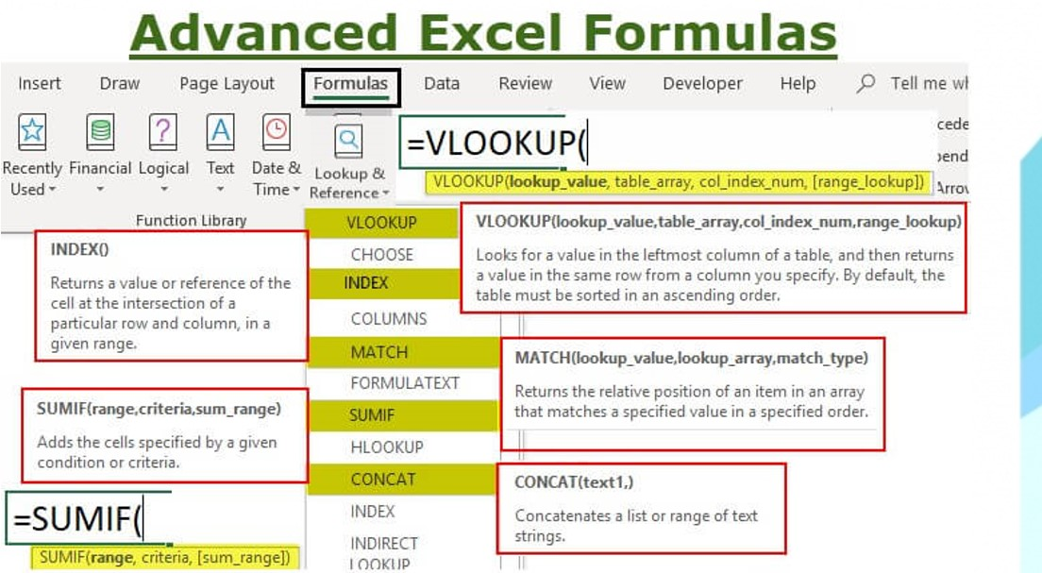

Slide 16
Demonstration of Advanced Tips & Tricks
3D Referencing (Live Practical Exposure)
Auto Summary Formation (Live Practical Exposure)
Get Pivot Data Summary (Live Practical Exposure)

Slide 17
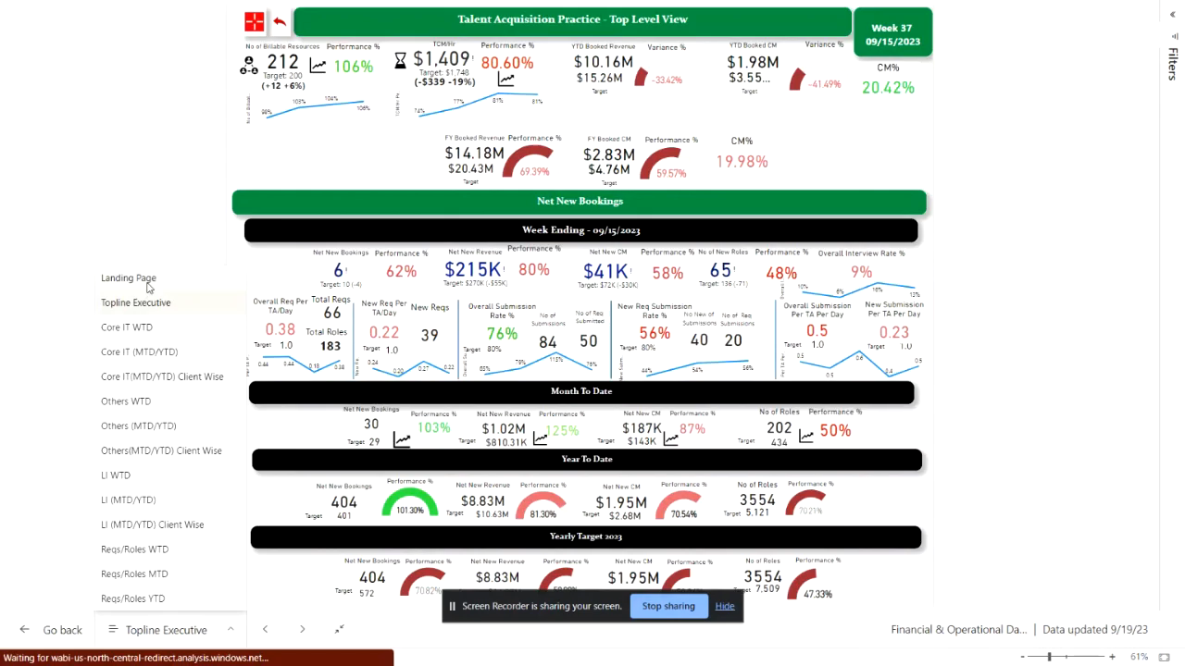
Recent Developments

Slide 18
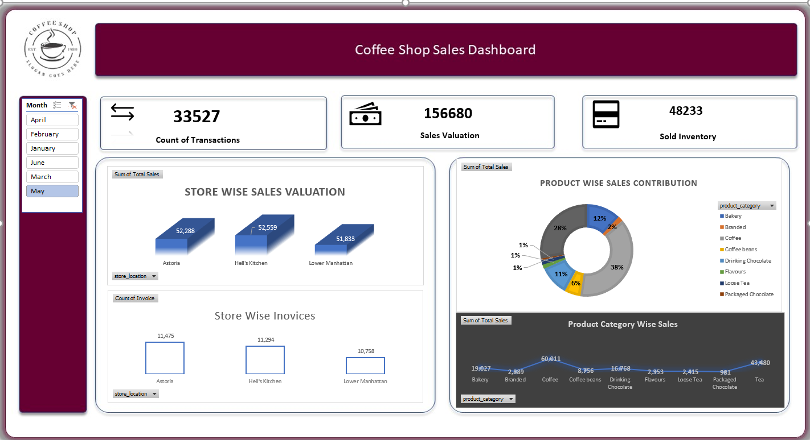
Recent Developments

Slide 19
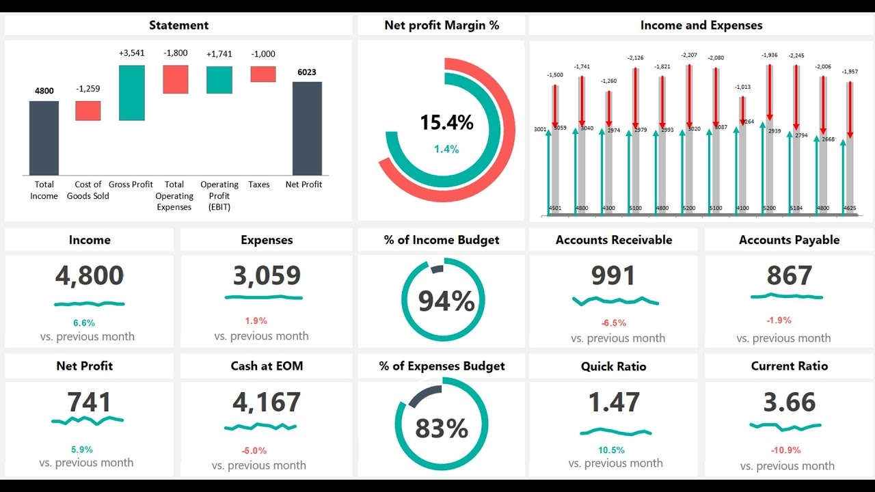
Dashboard Previews

Slide 20
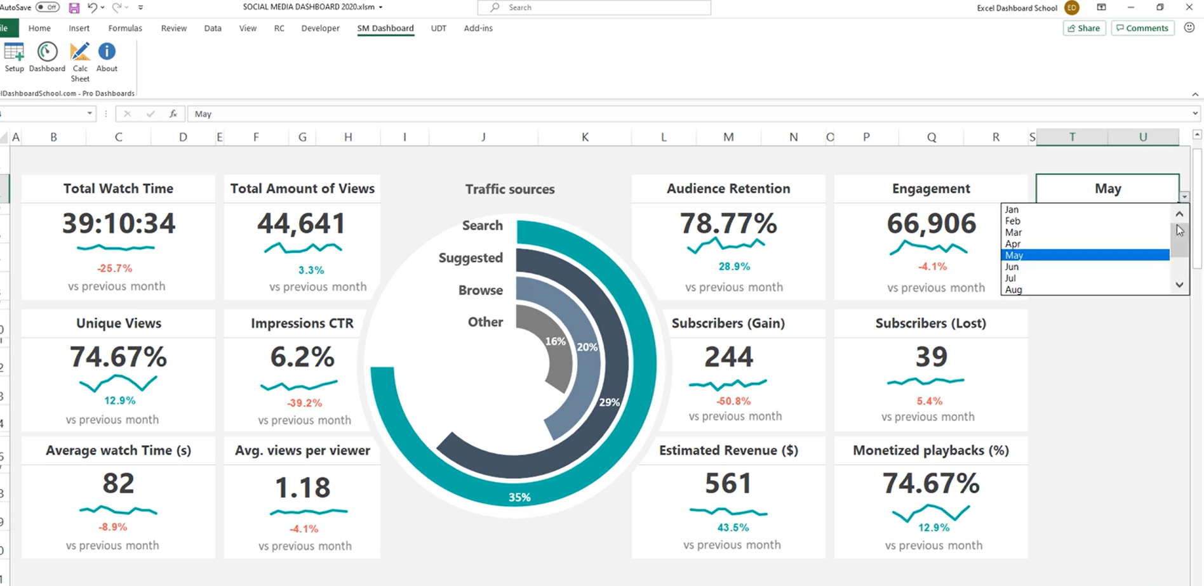
Dashboard Previews

Slide 21
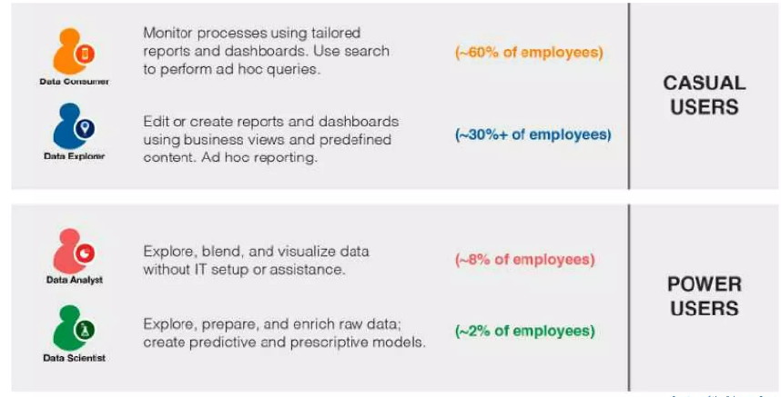
Classify Users by Needs

Slide 22
Sure Skill for Every Professional
Most demanded skills for employment across many industries
Certification in MS Excel opens many doors of opportunities for you
Used in a variety of business settings, from project management HR to Finance to anyone who is a Microsoft Excel expert is always in demand

Slide 23
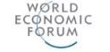
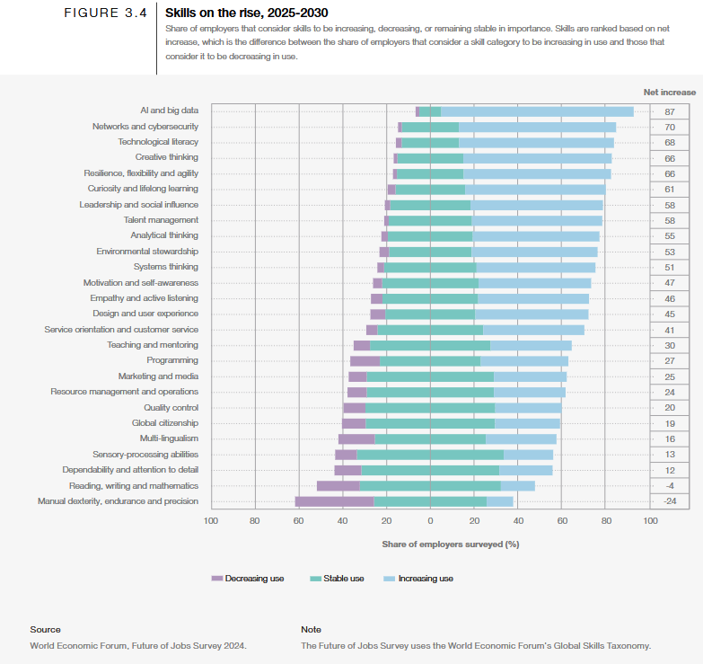
Emerging Career Paths – Are We Ready?

Slide 24
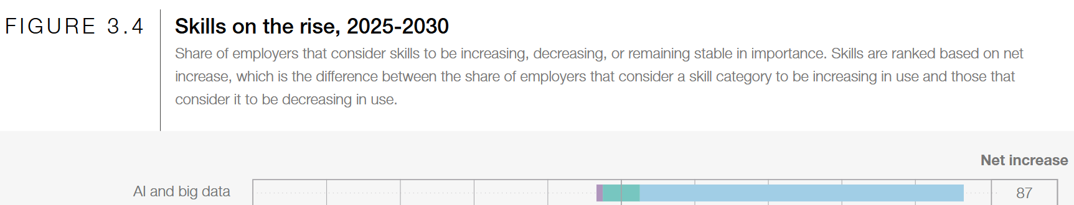
Emerging Career Paths – Are We Ready?

Slide 25
About YouExcel
FINTECH training firm and consultancy
Vision: To bridge the skills gap through industry-academia linkages
Registered with Sindh Technical Education and Vocational Training Authority, Government of Sindh
Affiliated with Trade Testing Board, Government of Sindh
Official training partner with NAVTTC, Govt. of Pakistan

Slide 26
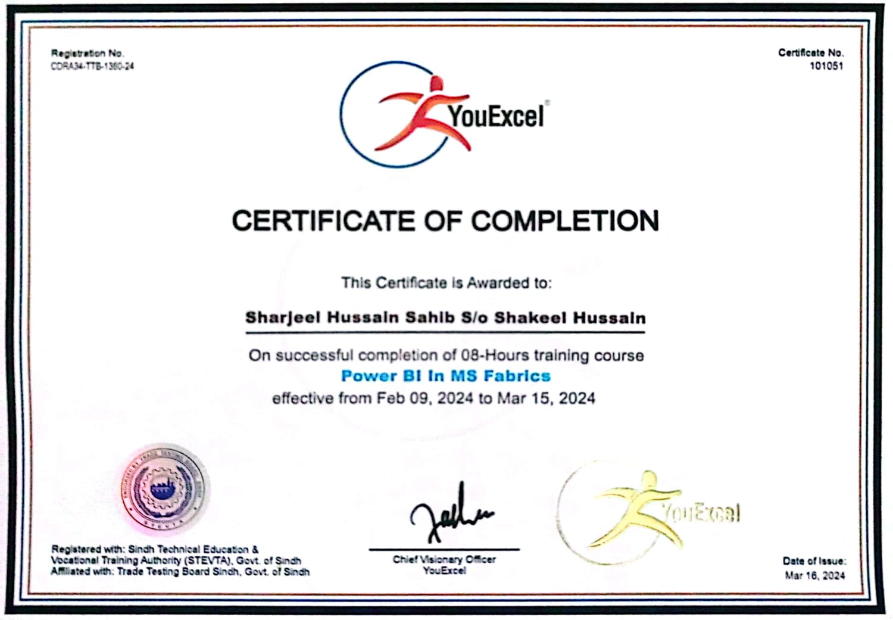

Government Endorsed QR Code based Certificate

Slide 27
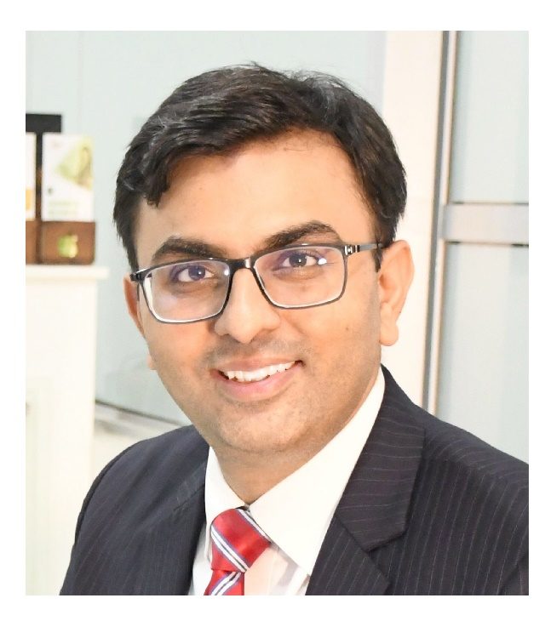
Facilitators
Farhan Shahid Qazi is Founder & Chief Visionary Officer at YouExcel.
He is ACCA Member holding BSc Applied Accounting from Oxford Brookes Uni, UK. He has achieved Train the Trainer certificate by the Association of Talent Development (ATD), USA. He is convenor Skills Development Central SC at FPCCI.
Farhan’s cross-cultural international business exposure of over 10 years working in London and in Dubai in a Fortune 500 company has enabled him to positively influence youth on achieving their career goals and learning employability skills through his educational entrepreneurial venture registered as YouExcel.
Farhan Shahid Qazi
Founder & CVO - YouExcel
ACCA Member, UK
BSc Applied Accounting, UK
ATD Verified Trainer, USA

Slide 28

Facilitators
Uzair Rasheed is Experienced business and data analyst consultant, associated with many industries like FMCG, Retail, Textile, HR, IT, Telecommunication, Banking, and NGO.
He is currently associated with Systems Limited and previously served at Hilal Food Group Pvt Ltd, in the capacity of Associate Manager – Business Intelligence, further he is serving as a seasonal consultant in Arthur Lawrence Group LLC (USA) as a Business Analyst.
Uzair Rasheed
Lead Effective Trainer
YouExcel
Masters Degree Holder

Slide 29

Training Partnership with NAVTTC,
Govt. of Pakistan

Slide 30
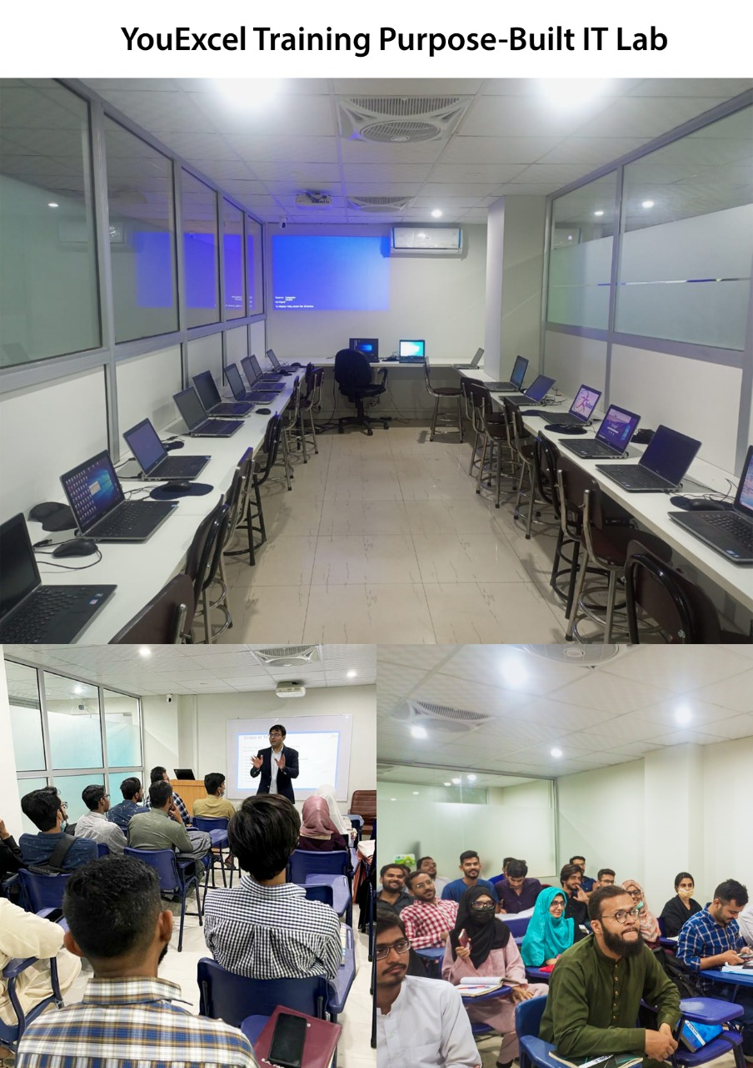
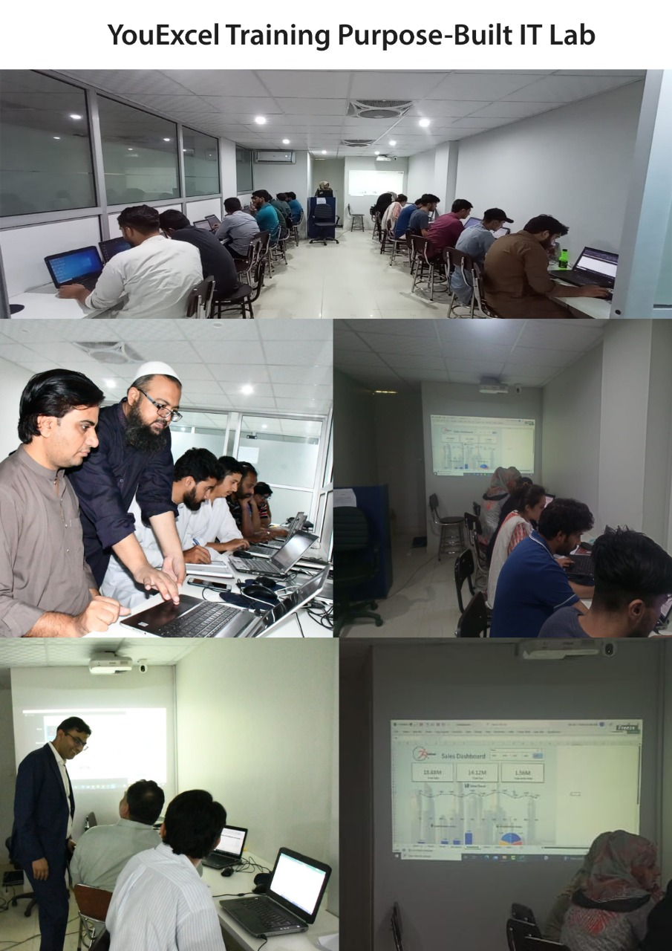
Portfolio

Slide 31
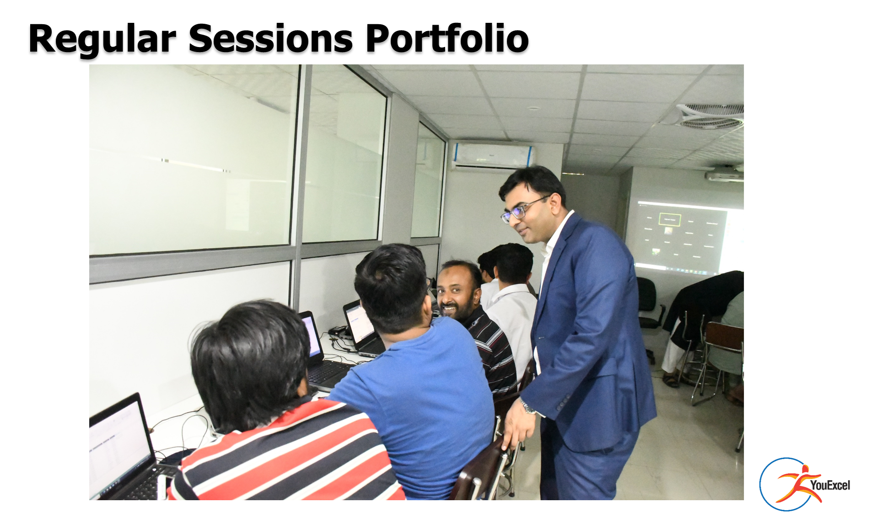

Slide 32
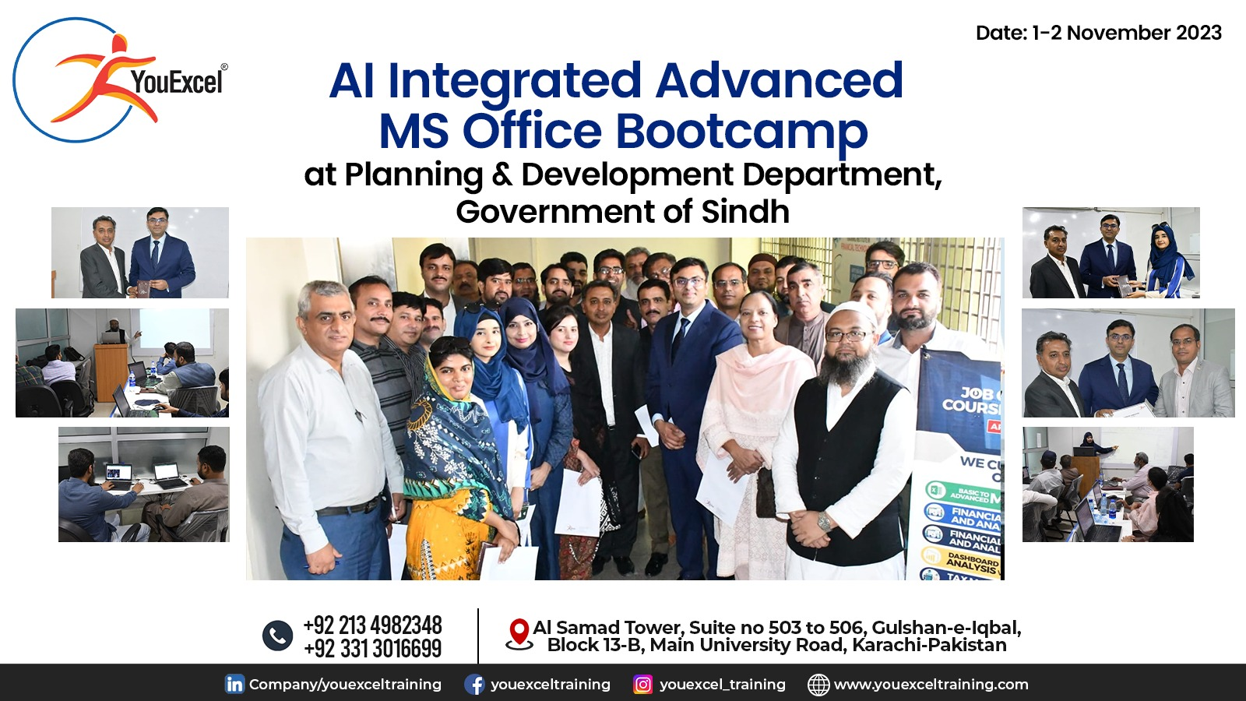
Corporate Portfolio

Slide 33
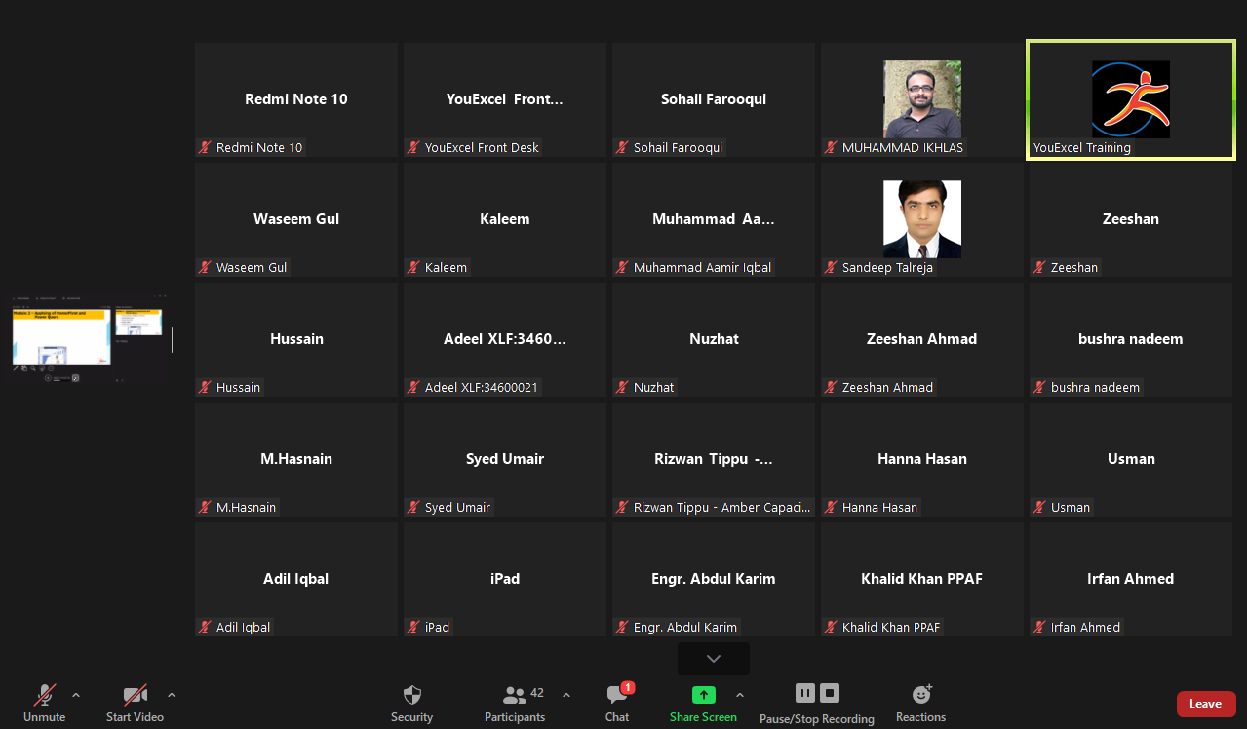
Portfolio

Slide 34



Slide 35
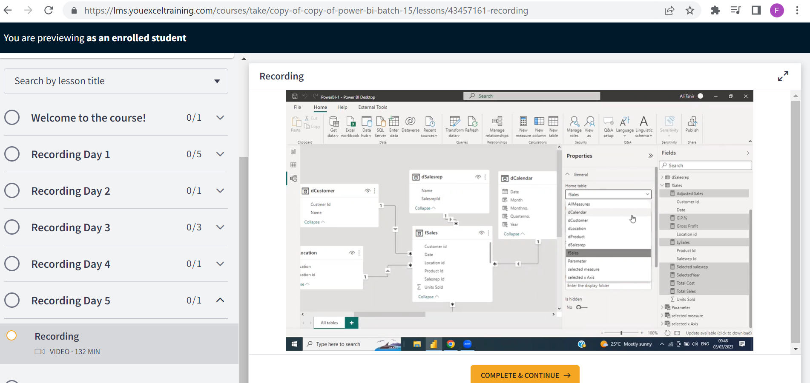
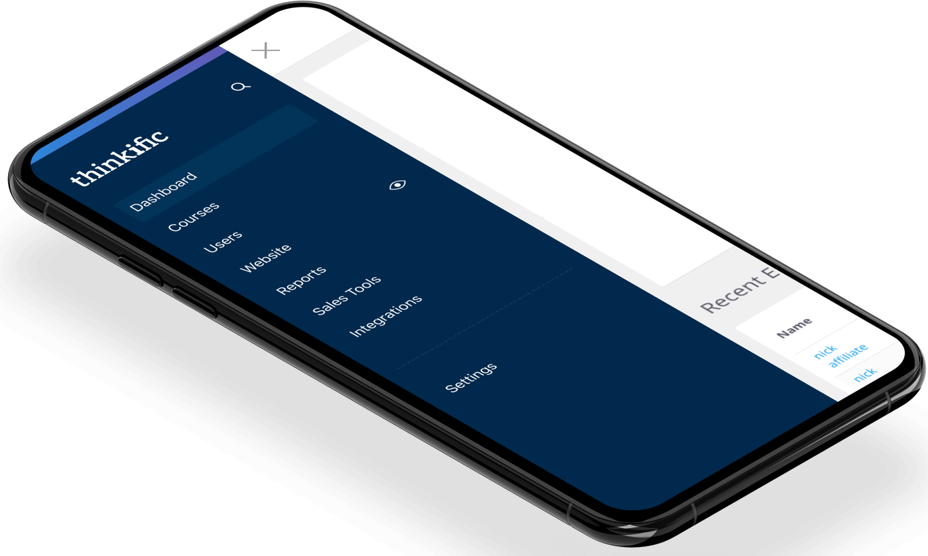
Customized LMS Interface Preview

Slide 36
Schedule
Become Advanced MS Excel Expert
Every Sunday starting from:
Sunday 19-January-2025 | 11:00AM-02:00PM
24 Hours in 2 Months

Slide 37



Slide 38
Take Admission and Upskill Yourself in 2025 with:
Bonus:
2 Hours Extra!!!
What You Will Get:
Live case study-based teaching to integrate actual scenarios
LMS Recording Access for Lifetime
WhatsApp community support for Lifetime
Recognized Government Trade Testing Board - Certificate of Completion upon submission of final project
Admission Form Link: https://youexceltraining.com/Registration-Form/Advanced-MS-Excel
Investment: PKR 11,000/- per month | PKR 20,900 Lumpsum
For You Today ONLY with 10% Discount:
PKR 9,900 per month | PKR 18,800/- Lumpsum
Hurry Up! Exclusive Offer Ends
Tuesday 14-January-25 | 3:00 P.M

Slide 39
To Invest in Your Skills:
Admission Form Link: https://youexceltraining.com/Registration-Form/Advanced-MS-Excel
Mode of Payment (Bank Details shared upon request):
Online Transfer
Direct Deposits in Bank
Jazz Cash Registered Account

Slide 40
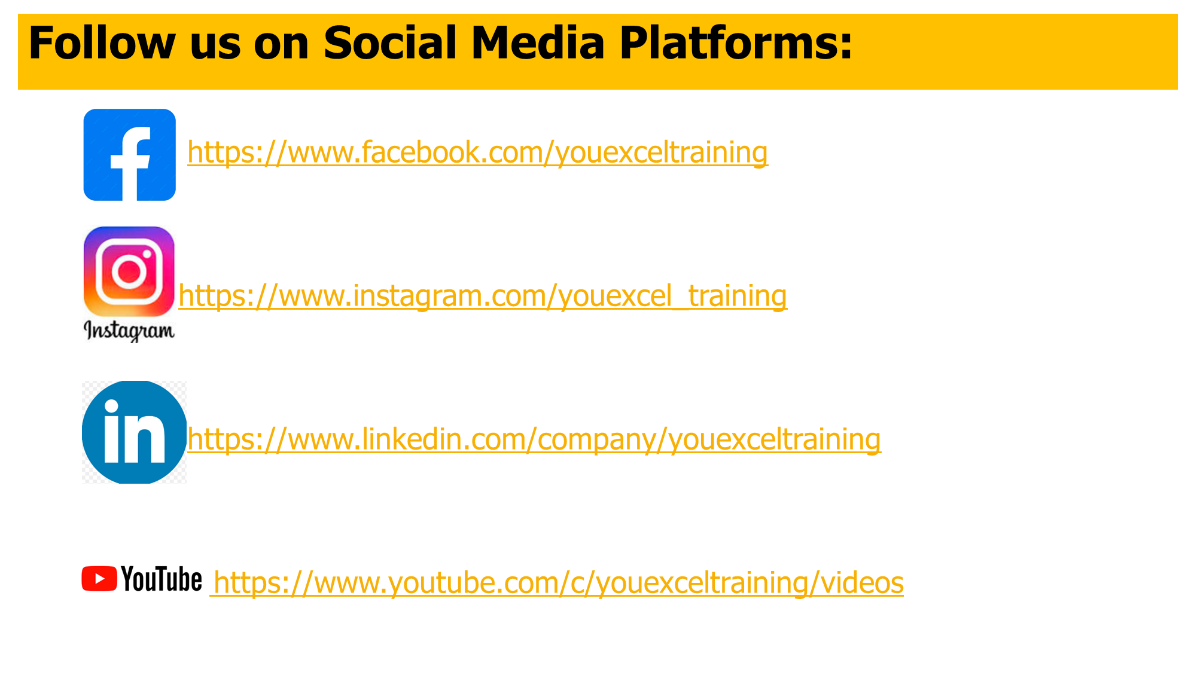


Slide 41

Thank You!
Add: 503-506, Al Samad Tower, Block 13-B, Main University Road, Gulshan-e-Iqbal, Karachi, Pakistan.
Web: www.youexceltraining.com
Cell/WhatsApp: +92-331-3016699 | Landline: +92-21-34982347-8

